Slide 1

Yellevate Dispute Analysis
Project Assignment | Batch 7 | Group 14

Slide 2

INTRODUCTION
Using data the company collected with regards to their invoices, the team will identify the cause of their revenue lost for the past few years.
Presentation by
GROUP 14
Leader
Armecin, Jan Riel
Members
The analysis to be presented will help the company to come up with actionable strategies to solve them.
Abaleta, Oliver
De La Paz, Archie Neil
Felizardo, Mary Rose
Lacson, Vivencio
Lazaro, Azeneth

Slide 3





Key Findings
Project Overview and Analysis
CONTENTS
Insights
Recommendations

Slide 4

PROJECT OVERVIEW
AND ANALYSIS

Slide 5

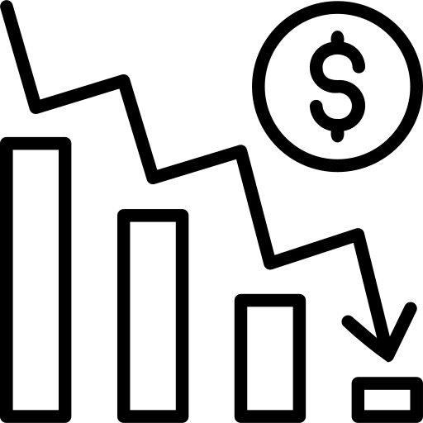
Project Overview
And Analysis
Yellevate is a company that specializes in providing marketing services to other companies. For the past few years, Yellevate has been struggling with client disputes. The company defines disputes as clients expressing dissatisfaction with the company’s services and refusing to pay for them.
This has been a huge financial burden for the company: statistically, 20% of the disputes raised against Yellevate resulted in a payment opt-out. This has led to an approximate 5% annual loss of revenue (USD).

Slide 6


The quality of the services provided is not the main driving reason for these invoice disputes
Important Assumptions
Yellevate management believes most disputes are the result of contract technicalities or clients thinking they can get away with not paying for the services.

Slide 7
DATA ANALYSIS
The data provided by the company is dataset of invoices for all the completed services Yellevate was hired to do from January 2020. – January 2022.
The following is the necessary information the executives needed:
to identify the circumstances around the disputed problems.
The processing time in which invoices are settled.
(average # of days rounded to a whole number)
The processing time for the company to settle disputes. (average # of days rounded to a whole number)
Percentage of disputes received by the company that were lost. (within two decimal places)
Percentage of revenue lost from disputes.
(within two decimal places)
The country where the company reached the highest losses from lost disputes. (in USD).

Slide 8

KEY
FINDINGS

Slide 9

vvvv
The average number of days which the invoices are settled.
The average processing time to settle invoices.
26 days

Slide 10
vvvv
The average processing time to settle invoices per country.
Country | Days
China | 23
Spain | 25
France | 28
United States | 28
Russia | 29

Slide 11

Disputes
Disputed
Total Invoices | 2466
Disputed | 571
Undisputed | 1895

Slide 12
vvvv
The average number of days to settle disputes.
The average processing time to settle disputes.
36 days

Slide 13
vvvv
The average processing time to settle disputes per country.
Country | Days
China | 34
France | 34
Spain | 37
Russia | 38
United States | 41

Slide 14
vvvv
Percentage of disputes received by the company that were lost.
LOST
23%
Won
disputed
17.69%
82.31%

Slide 15
vvvv
Percentage of disputes received per country.

Slide 16
vvvv
Percentage of revenue from dispute cases.
TOTAL REVENUE (USD) | 14,770,318
Won | 14,080,151
Lost | 690,167

Slide 17
vvvv
Revenue lost from disputes per country.
Country | Revenue Amount | Lost Revenue Percentage
France | 526,264 | 3.56%
Russia | 81,291 | 0.55%
China | 42,630 | 0.29%
United States | 22,936 | 0.16%
Spain | 17,046 | 0.12%
Total | 690,167 | 4.67%

Slide 18

INSIGHTS

Slide 19
INSIGHTS
The data gathered showed that the first disputed invoice was around February 2020, which was also within the time the Covid Pandemic took place. For this reason, the customers might assume or expect an exemption in their contract but was not granted. The adjustment of employees for their work-from-home set-up might have also affected the communication with the customers, possibly resulting in processing of disputes to be settled late.
According to our findings, disputes that have been settled late are most likely to be lost by the company. France, being the country where the company reached the highest losses from lost disputes, is also the country with the most disputes that are settled late.

Slide 20
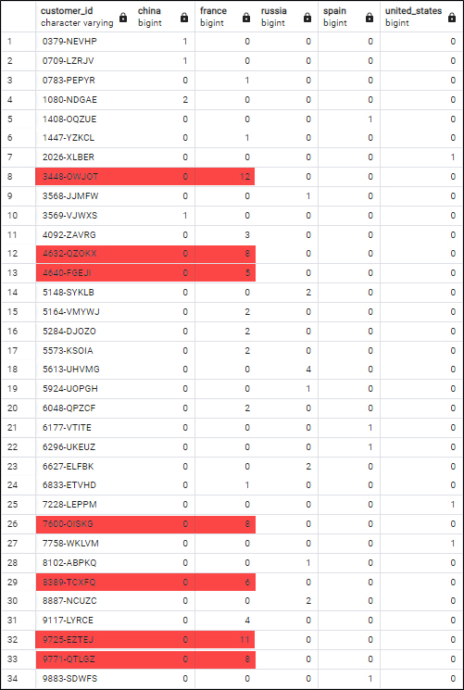
We have also found out that there are customers that have been winning multiple disputed cases. Either these customers are loyal to Yellevate despite being unsatisfied with its services multiple times, or these customers have found loopholes in the contract and are abusing the system.
INSIGHTS

Slide 21

RECOMMENDATIONS

Slide 22
RECOMMENDATIONS
Improve the processing time of settling disputes by keeping constant communication between the company and its customers, especially if one party requests to renegotiate the contract.
The company may also conduct more thorough background checks and screening of their clients before signing a contract, especially customers with a history of a dispute which was lost by the company.
The company may also review the history of cases, on how the company lost them by keeping an open communication to avoid losing the same dispute and by analyzing and improving the parts of the agreement that the customers based their disputes on.
To avoid or minimize revenue loss, discuss with the customers and offer them incentives like discounts on future service requests for them to consider not opting out of their payment.

